Slide 1


EDA
For VQA TextMining’s Project

Slide 2


Data info
Images: 23008
QA-pairs: 235421
Questions: 57300
Answers: 108

Slide 3

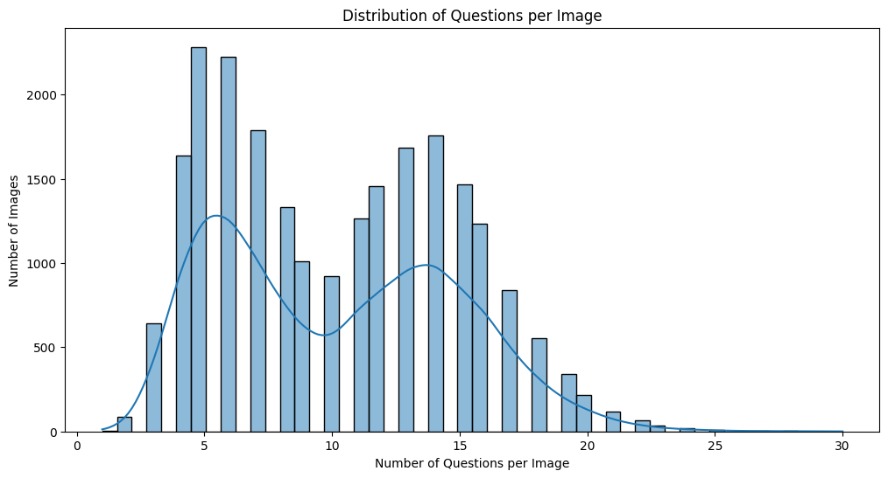


Slide 4

Top 10 question
Top 10 Questions Leading to Yes/No Answers:
Are there any person in image? 12300
Are there any cup in image? 2152
Are there any bowl in image? 2080
Are there any vase in image? 1566
Are there any car in image? 1452
Are there any wine glass in image? 1418 Are there any dining table in image? 1371 Are there any dog in image? 1354
Are there any bird in image? 1338
Are there any bottle in image? 1331
Top 10 Questions Leading to Numeric Answers:
How many person in image? 12207
How many cup in image? 1950
How many bowl in image? 1879
How many vase in image? 1368
How many car in image? 1284
How many dog in image? 1182
How many wine glass in image? 1175
How many dining table in image? 1151
How many bottle in image? 1129
How many bird in image? 1114
01
02

Slide 5
Top 10 question
Top 10 Questions Leading to Color Answers:
What color is the sky? 562
What color is the background? 353
What color are the leaves? 263
What color are the flowers? 248
What color is the shirt? 228
What color is the grass? 217
What is the color of the sky? 205
What color is the jacket? 177
What color is the table? 167
What color is the water? 149
Top 10 Questions Leading to Position Answers:
Where is the vase? 73
Where is the teddy bear? 65
Where is the fork? 51
Where is the clock? 44
Where is the book? 35
are the flowers? 34
Where is the knife? 34
Where is the glass? 33
Where is the plant? 31
Where is the wine glass? 31
01
02

Slide 6
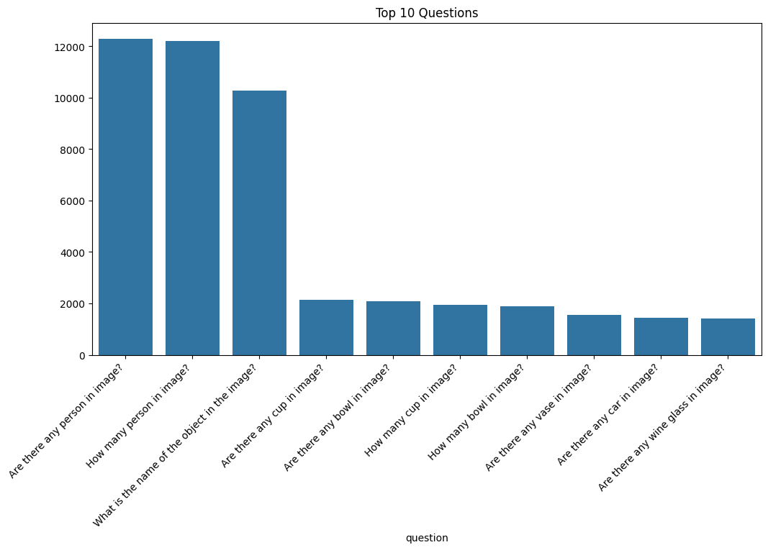

Slide 7

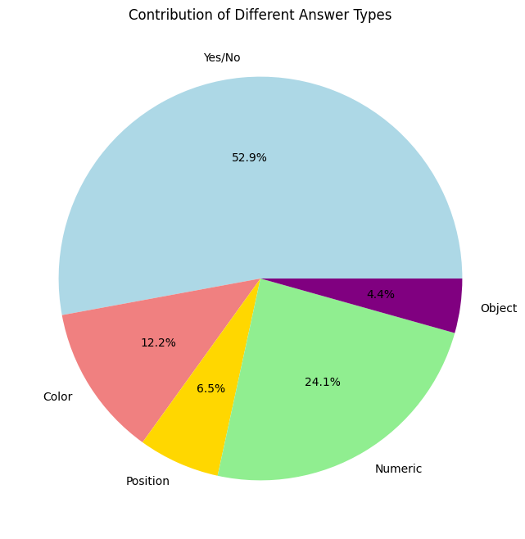


Slide 8
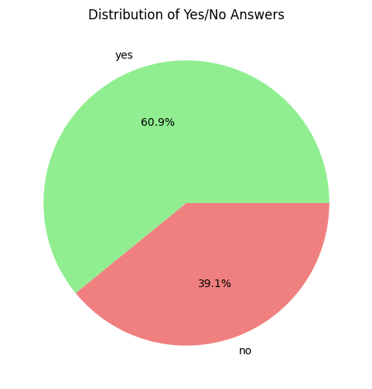

Slide 9

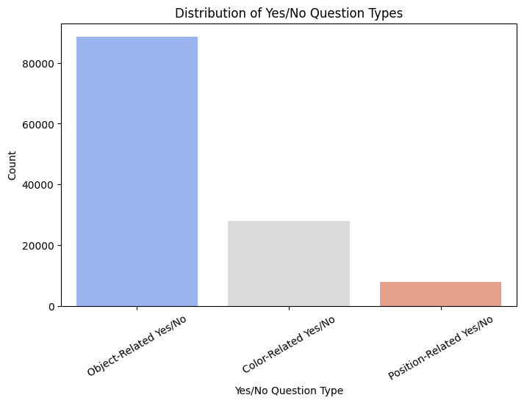


Slide 10
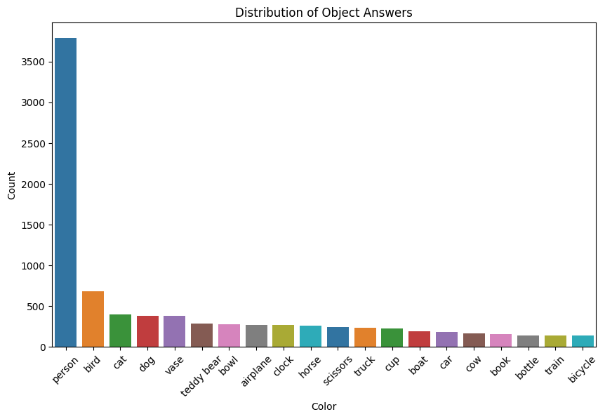


Slide 11
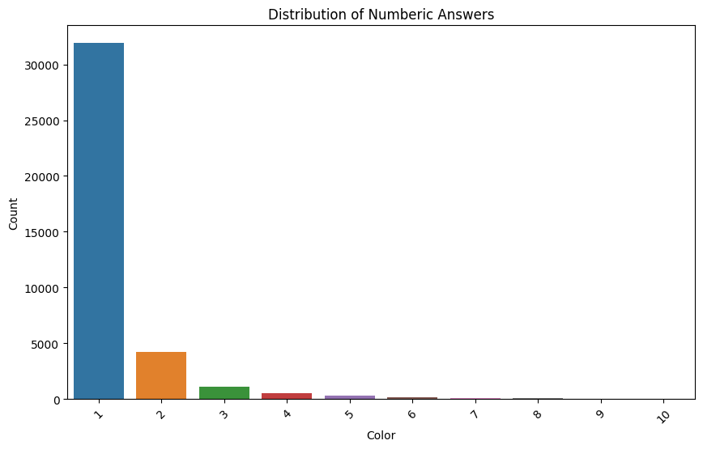

Slide 12
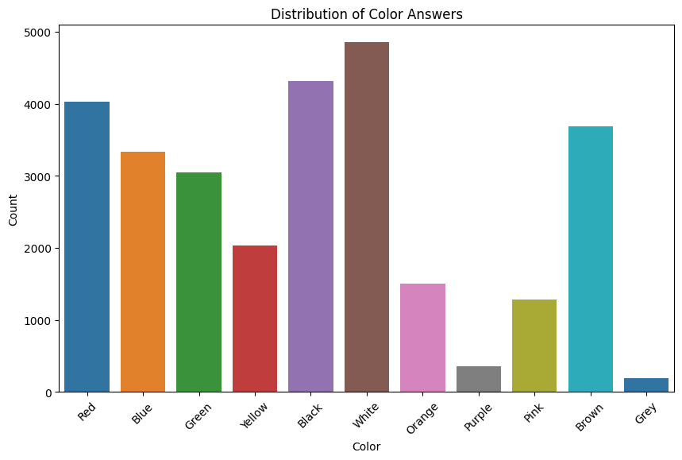

Slide 13
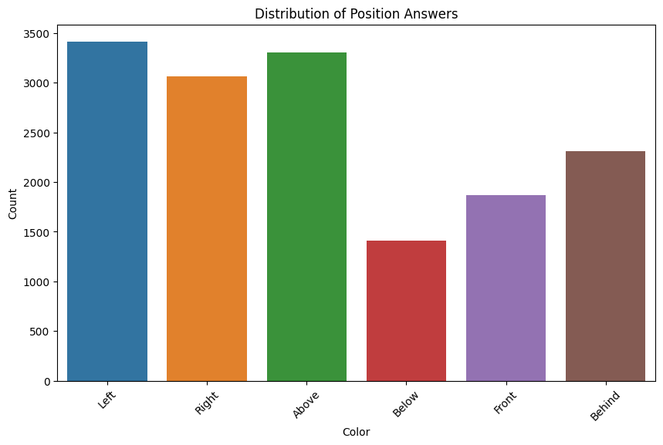


Slide 15
Test info
Eval info
Images: 2417
Questions: 7961
Answers: 87
Images: 4486
Questions: 13460
Answers: 91
Train info
Images: 16105
Questions: 42073
Answers: 105

Slide 16
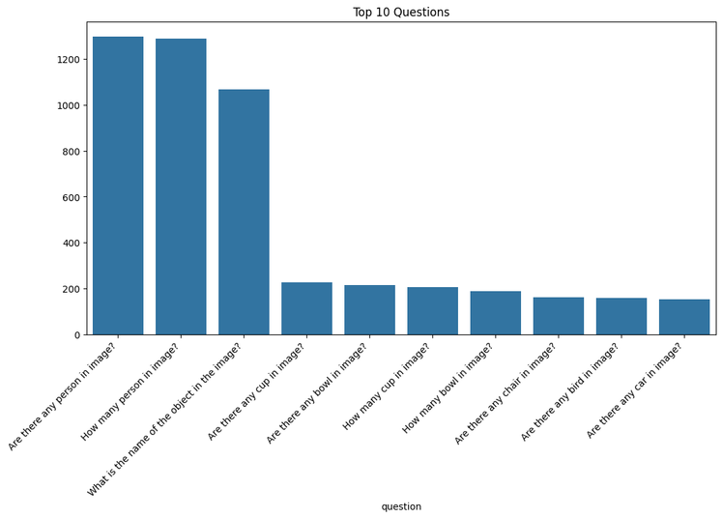
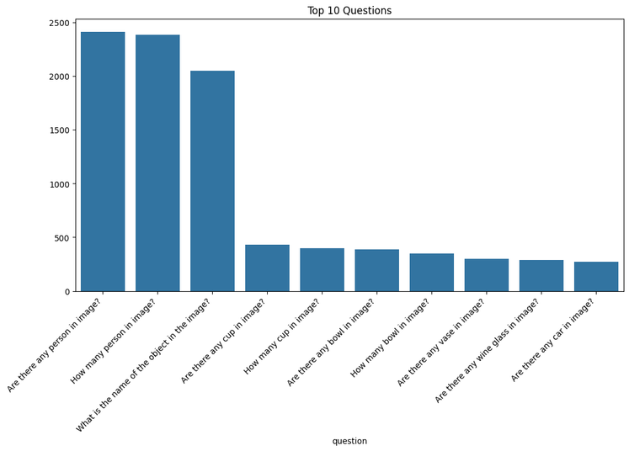

Test sets
Eval set
Train set

Slide 17

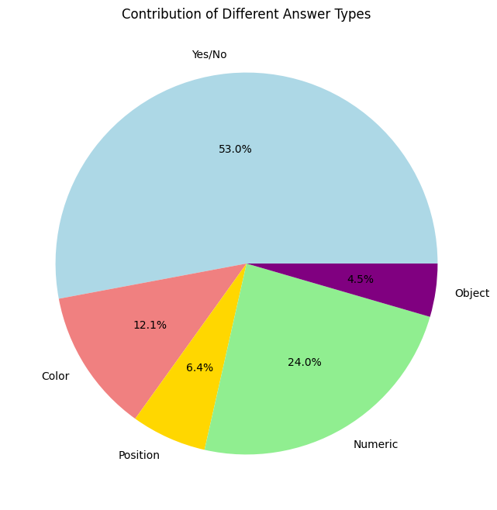

Test set
Eval set
Train set

Slide 18



Test set
Eval set
Train set

Slide 19
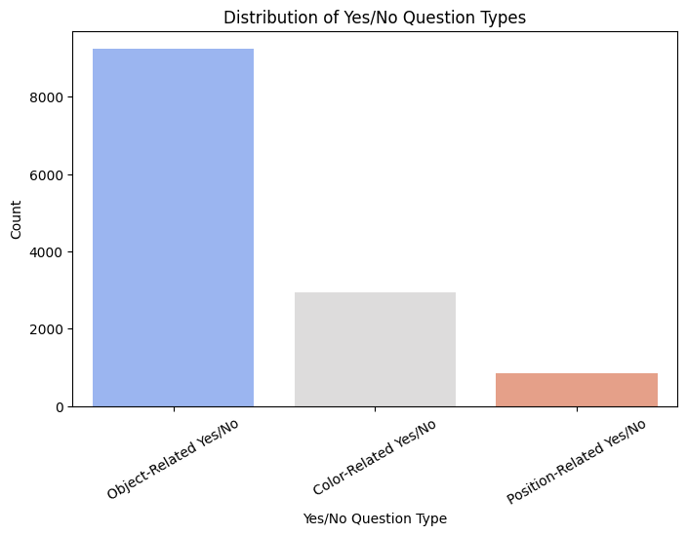


Test set
Eval set
Train set

Slide 20
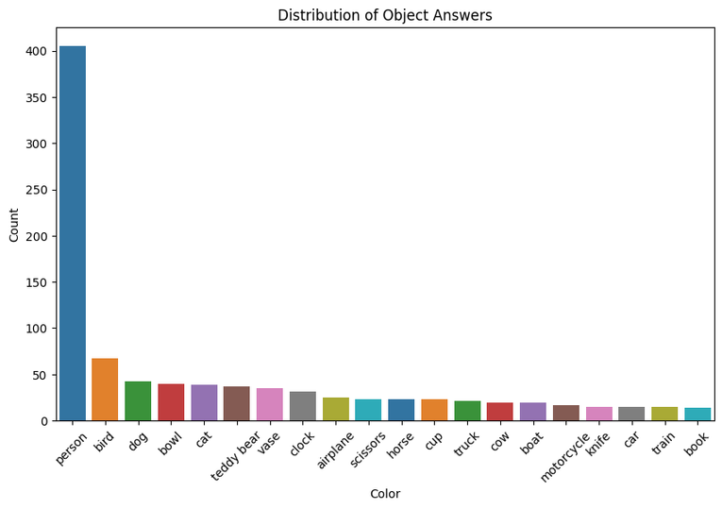
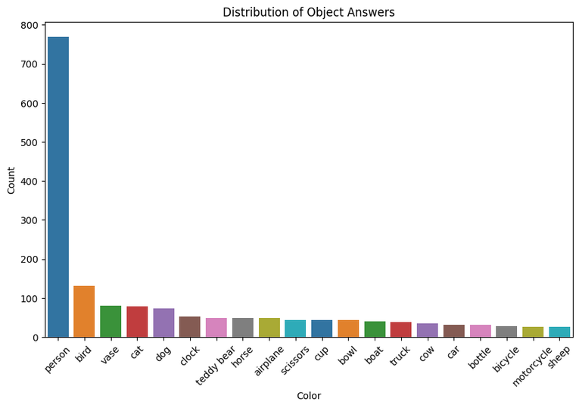

Test set
Eval set
Train set

Slide 21
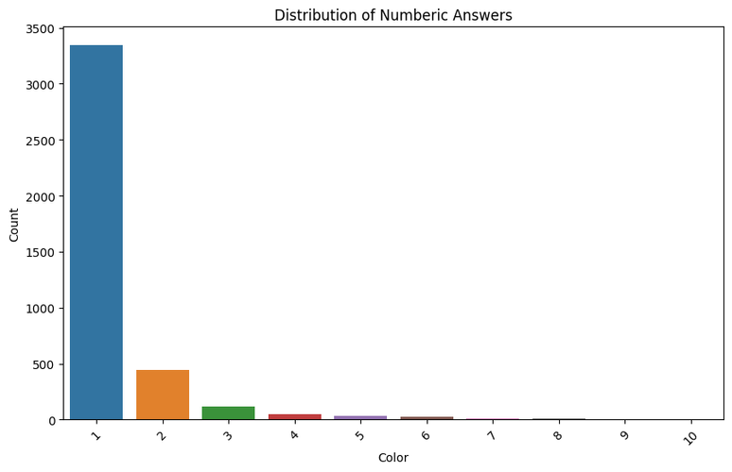
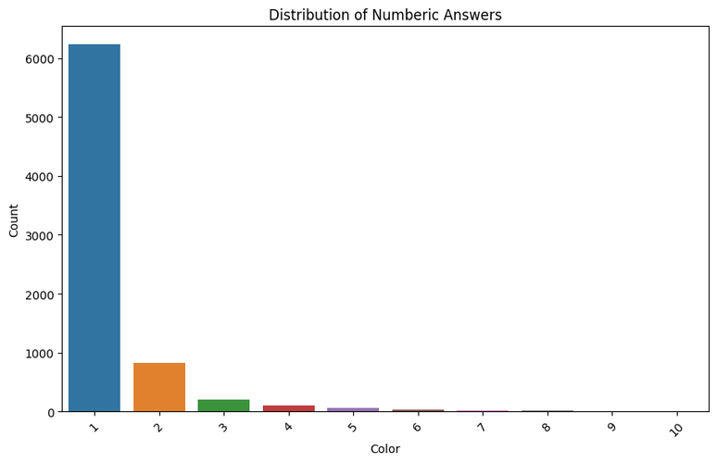

Test set
Eval set
Train set

Slide 22
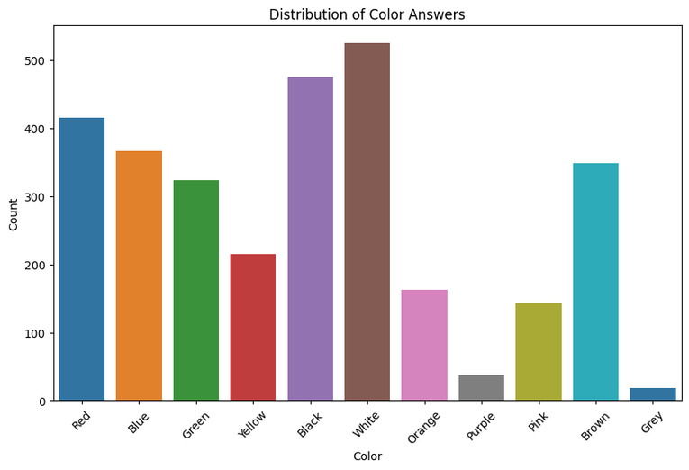
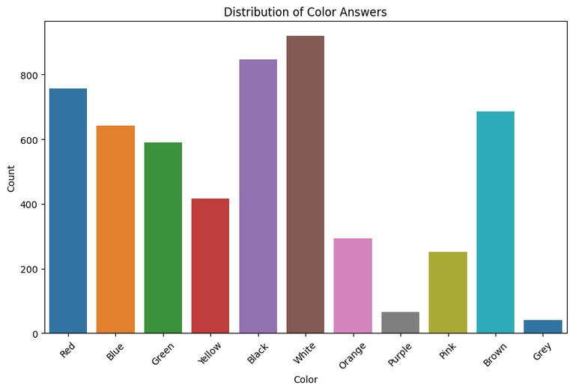
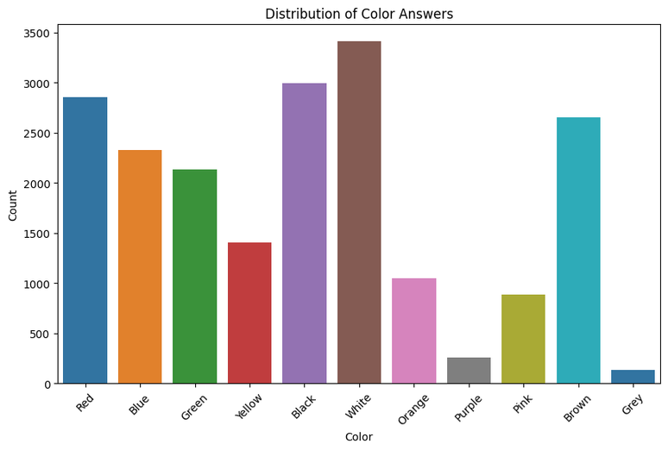
Test set
Eval set
Train set

Slide 23
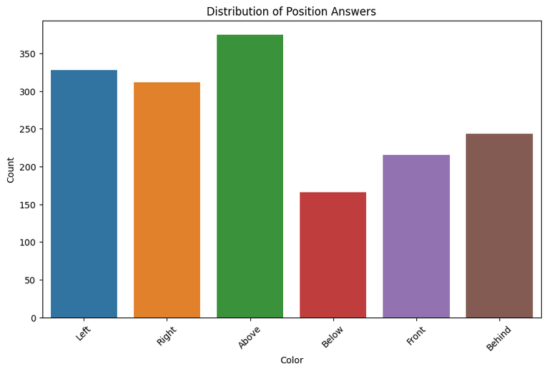
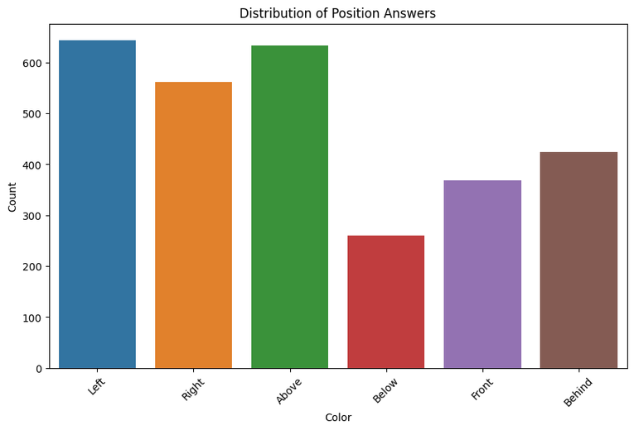
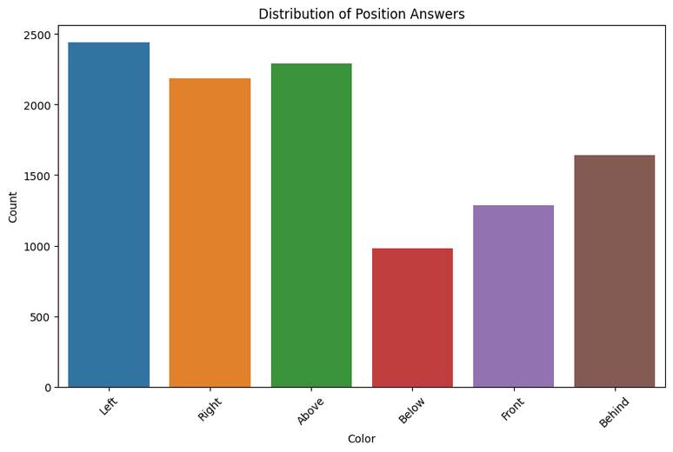
Test set
Eval set
Train set

Slide 24
Models
ViLt
Beit-3

Slide 25
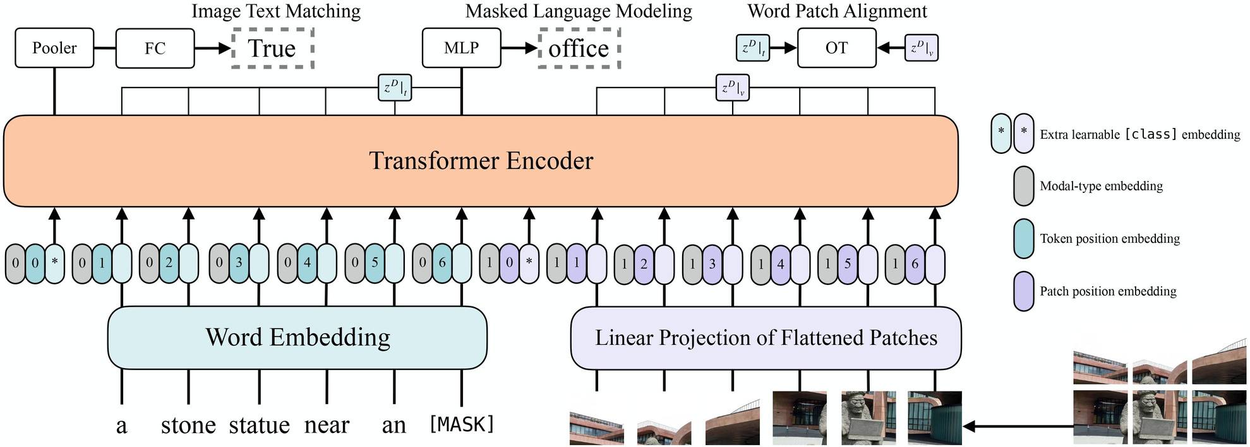
ViLT

Slide 26
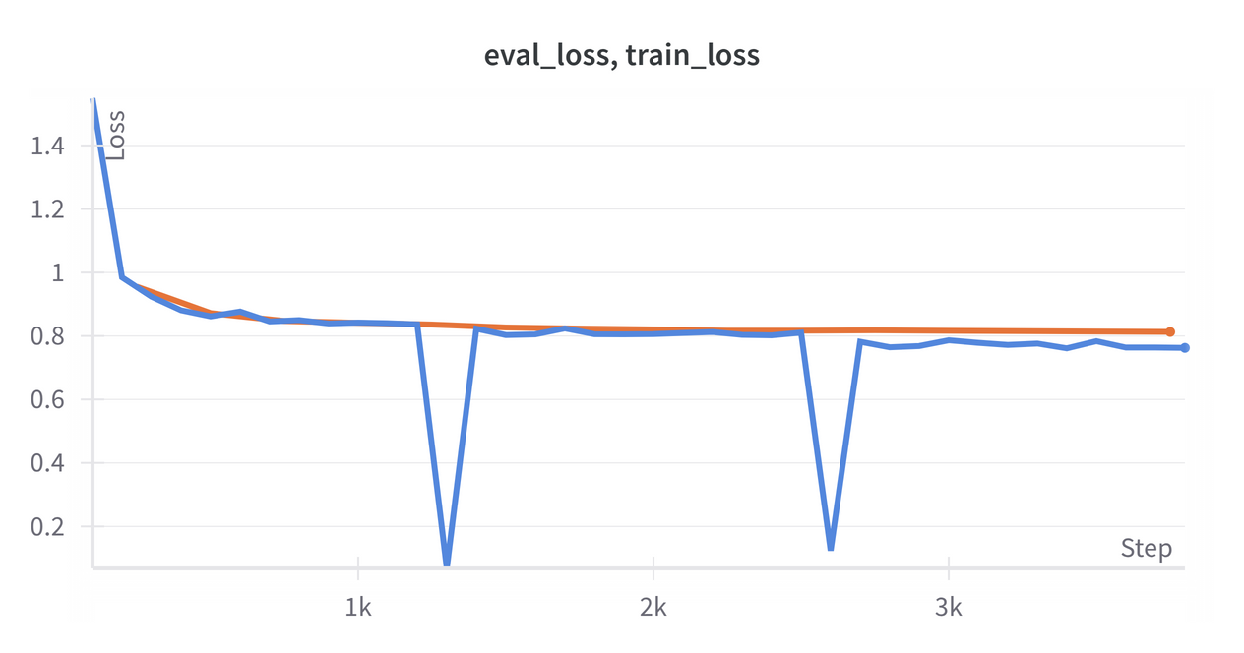
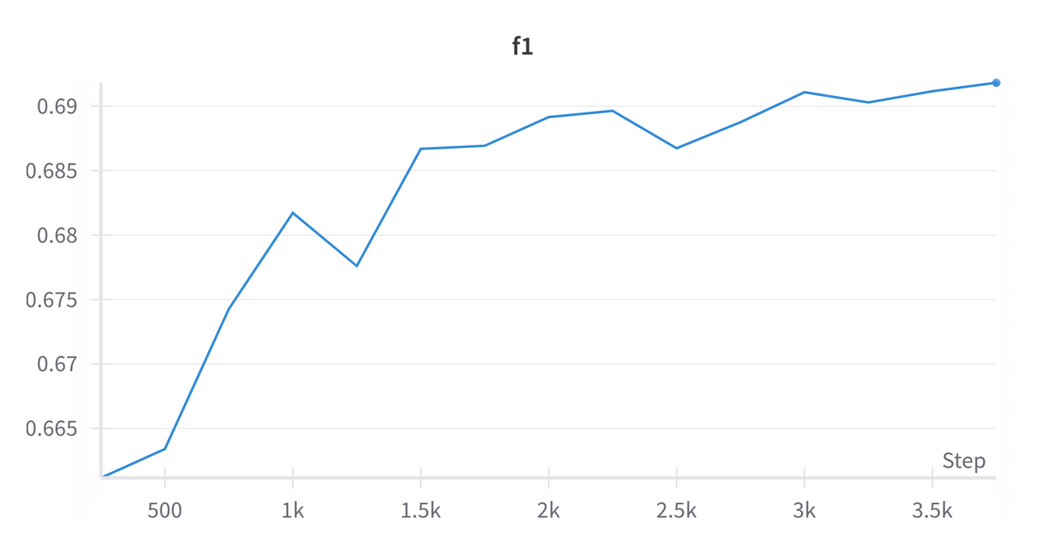
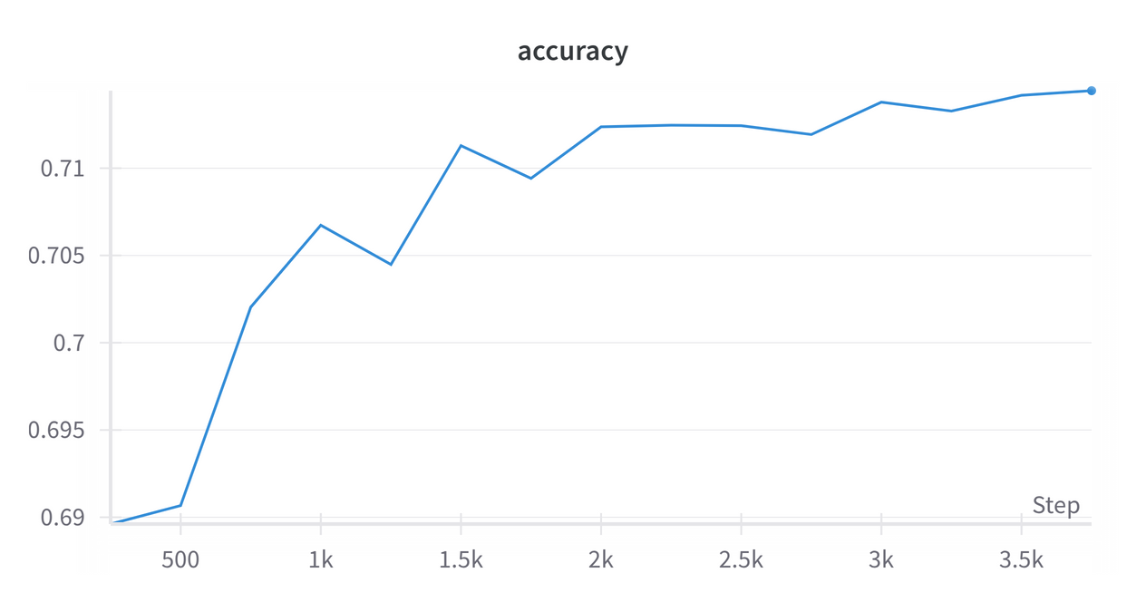
Finetune from
dandelin/vilt-b32-finetuned-vqa

Slide 27
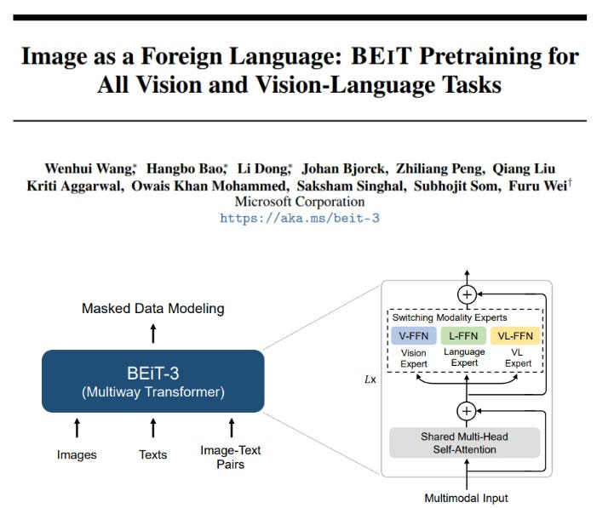
Beit-3

Slide 28
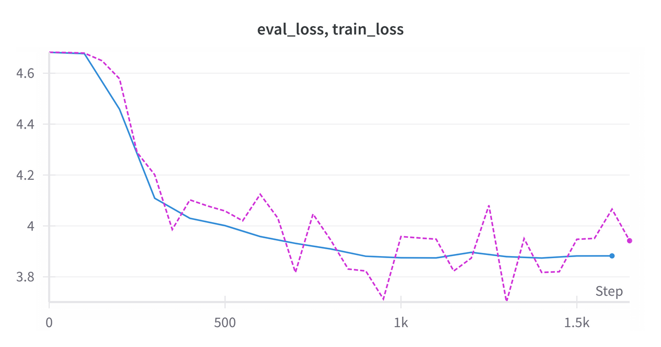
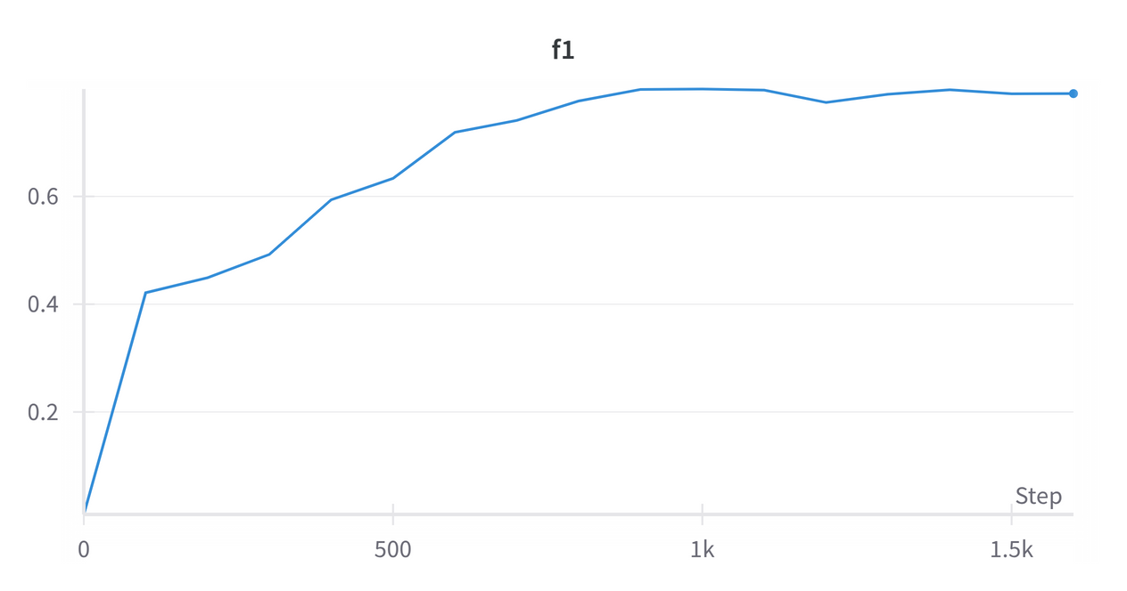
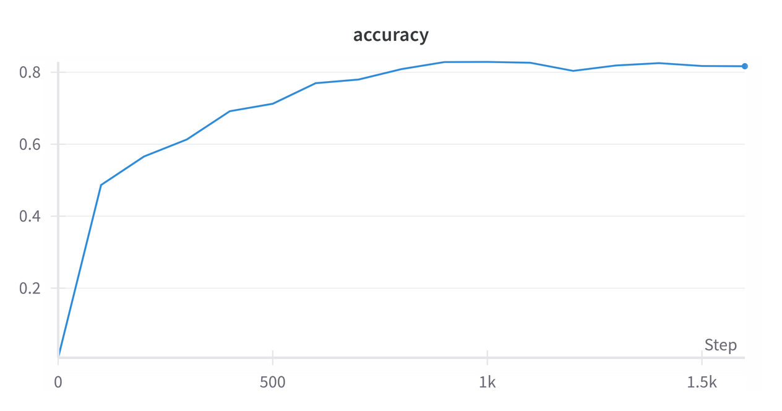
beit3_base_patch16_224 (VQAv2 finetuned)

Slide 29


Thanks for watching

